Slide 1
Explore fundamental concepts in algorithms and data structures.
Module 1: Introduction to Algorithms
Week 1
Understand core data structures and their operations.
Module 2: Basic Data Structures
Week 2
Discover basic sorting techniques and performance analysis.
Module 3: Sorting Algorithms P1
Week 3
Examine advanced sorting methods and efficiency improvements.
Module 4: Sorting Algorithms P2
Week 4
Learn fundamental searching algorithms for data retrieval.
Module 5: Searching Algorithms P1
Week 5
Explore advanced search structures and optimization strategies.
Module 6: Searching Algorithms P2
Week 6
Public Holiday
Week 7
No class scheduled due to a public holiday.
Grasp basic graph theory and traversal techniques.
Module 7&8: Graph Algorithms P1
Week 8
Dive into advanced graph algorithms, including shortest path methods.
Module 9: Graph Algorithms P2
(lecture on Tuesday)
Week 9
Study string matching and pattern searching techniques.
Module 10: String Process
Week 10
Investigate dynamic programming and other sophisticated algorithm strategies.
Module 11: Advanced Algorithms
Week 11
Notes:
In this module, we will learn how Sorting Algorithms are structured, analyze their time complexity, and see visual step-by-step demonstrations of their processes.

Slide 2
Module 3: Sorting Algorithms
Note: Some of these slides have been adapted from
slides freely available on the Internet and also from the
slides accompanying the course textbook.
Notes:
In this module, we will learn how Sorting Algorithms are structured, analyze their time complexity, and see visual step-by-step demonstrations of their processes.

Slide 3
Revise previous week
Data Structures – Ways to store and manage data efficiently.
Abstract Data Types (ADTs) – Define operations without specifying implementation.
Stack & Queue Implementations – Capped, Expandable Stack & Queue, Incremental & Doubling Strategy.
Amortized Analysis - Used to evaluate average time per operation over multiple runs.
Notes:
Before diving into sorting algorithms, let’s briefly revisit the key concepts from the previous lecture.
Data Structures – Efficient ways to store and manage data. Choosing the right data structure can impact the performance of algorithms, including sorting.
Abstract Data Types (ADTs) – Define how data can be manipulated without specifying implementation details. Understanding ADTs like stacks and queues helps in designing better algorithms.
Stack & Queue Implementations – We explored different ways to implement these structures, including fixed-size (capped) and expandable versions. The strategies for expansion, such as incremental growth and doubling, affect efficiency.
Amortized Analysis – A method used to evaluate the average time complexity of operations over a sequence of operations, rather than in isolation. This concept helps analyze performance trade-offs, which will also apply to some sorting algorithms.

Slide 4
Learning outcomes
After completing this module, you will be able to:
Understand the core ideas of Selection Sort, Insertion Sort, Bubble Sort, and Merge Sort
Work through examples illustrating how each algorithm operates
Compare their performance in terms of time and space complexity
Notes:
Understanding Sorting Algorithms – Learn the core concepts behind Selection Sort, Insertion Sort, Bubble Sort, and Merge Sort, including how they function and when to use them.
Step-by-Step Examples – See how each algorithm processes a list, with visualizations of sorting in action. This helps in understanding how data moves and changes throughout the sorting process.
Performance Comparison – Analyze the time complexity (O(n²) vs. O(n log n)) and space complexity of each algorithm to determine which is best suited for different situations.
Mastering these concepts helps in choosing the right sorting technique for different types of problems, improving both efficiency and problem-solving skills.

Slide 5
Topics
Selection Sort
Insertion Sort
Bubble Sort
Merge Sort
Notes:
Sorting is a fundamental operation in computing, used to organize data for efficient searching, processing, and retrieval.
In this module, we will study four key sorting algorithms: Selection Sort, Insertion Sort, Bubble Sort, and Merge Sort. Each of these algorithms follows a unique approach to sorting, and understanding their differences is essential for optimizing performance in different scenarios.
The focus will be on how each algorithm works, their step-by-step execution, and their computational efficiency. By the end, we will compare their strengths and weaknesses to determine the best use cases for each.

Slide 6
Motivation
Problem:
Turn this:
Into this:
As efficiently as possible!
10
19
7
4
3
21
10
23
24
18
1
8
23
1
12
1
1
3
4
7
8
10
10
12
18
19
21
23
23
24
Notes:
Sorting plays a crucial role in organizing data efficiently. Imagine receiving a list of randomly arranged numbers, and the goal is to sort them in ascending order. There are multiple ways to do this, but the challenge is to find the most efficient method.
The example here shows an unsorted array of numbers. The task is to transform it into a sorted list using the fewest steps possible. Some sorting methods may require many swaps and comparisons, while others use smarter strategies to achieve the same result with less effort. The algorithms we discuss today will help us understand which methods are best suited for different scenarios.

Slide 7
Sorting Algorithms
Some ways to sort arrays:
Iterative vs. recursive
Comparison-based vs. non-comparative
Most sorting algorithms we’ll analyze are comparison-based--that is, the sort is produced by comparing elements with each other
Notes:
Sorting algorithms can be categorized based on different approaches. The two main ways to classify them are:
Iterative vs. Recursive
Iterative algorithms, like Selection Sort and Bubble Sort, use loops to perform sorting operations. Recursive algorithms, such as Merge Sort, break the problem into smaller subproblems and solve them using recursion.
Comparison-based vs. Non-comparitive
Most sorting algorithms we cover in this lecture are comparison-based, meaning they compare elements directly to determine order. However, there are also non-comparison-based algorithms, such as Counting Sort and Radix Sort, which rely on alternative techniques like frequency counting and digit sorting.

Slide 8
Summary of Sorting Algorithms
Algorithm | Time | Notes
Selection sort | O(n²) | slow (good for small inputs)
Insertion sort | O(n²) | slow (good for small inputs)
Merge sort | O(n log n) | fast (good for large inputs)
Quick sort | O(n log n) expected | randomized fastest (good for large inputs)
Heap sort | O(n log n)
Notes:
Selection Sort and Insertion Sort belong to the O(n²) category, meaning they perform poorly on large datasets.
Merge Sort, Quick Sort, and Heap Sort, with their O(n log n) complexity, are more efficient for larger inputs.
Understanding this performance difference helps in choosing the right sorting method based on data size and application requirements.

Slide 9
1. Selection Sort: Example
Selection sort is a sorting algorithm that selects the smallest element from an unsorted list in each iteration and places that element at the beginning of the unsorted list.
Video: Selection Sort in 3 Minutes
Notes:
Selection Sort is a simple sorting algorithm that works by finding the smallest element in the unsorted portion of the list and swapping it with the first unsorted element. This process repeats until the entire list is sorted.
The list is divided into two parts: a sorted section (left side) and an unsorted section (right side).
The smallest element in the unsorted section is selected and moved to the correct position.
This continues until all elements are in order.
In this example, we start by identifying the smallest number in the entire list and swapping it with the first element. The process continues until the whole list is sorted.

Slide 10
1. Selection Sort: Pseudo Code
function selection_sort(A):
// Input: Unsorted List
// Output: Sorted List
n = A.length
for i = 0 to n-2:
min = argmin(A[i:n-1])
swap A[i] with A[min]
Topic: Selection Sort
Notes:
The algorithm above a straightforward structure. Given an unsorted list, we iterate through it while keeping track of the smallest element in the unsorted section. Once identified, this element is swapped with the first unsorted position.
The outer loop goes through each element in the list.
The inner operation finds the smallest remaining value and swaps it with the current position.
The list gradually becomes sorted from left to right.

Slide 11
1. Selection Sort: Another Example
min
53
25
13
22
9
9
25
13
22
53
9
13
25
22
53
9
13
22
25
53
9
13
22
25
53
SORTED
Topic: Selection Sort
Notes:
This step-by-step breakdown visually demonstrates how Selection Sort operates. The process involves scanning the unsorted portion to find the smallest value and placing it in the correct position. The shaded boxes represent elements that have already been sorted, while the highlighted number represents the current minimum.
In this example, the smallest number is found and swapped at each step:
1️⃣ Find 9, the smallest number, and swap it with 53. 2️⃣ Find 13, the next smallest, and swap it with 25. 3️⃣ Continue selecting and swapping until all elements are in order.
By the end, the list is fully sorted. The already sorted elements are shaded to show progress.

Slide 12
1. Selection Sort: Analysis
Divides input array into two logical parts
elements already sorted
elements that still need to be sorted
Selects the smallest element of the array and places it at index 0, then selects the second smallest and places it in index 1, then the third smallest in index 2, etc..
Advantages:
Very simple
Memory efficient: in-place means swapping elements within same array
Disadvantages:
Slow: runs in quadratic O(n²) time.
Topic: Selection Sort
Notes:
Selection Sort divides the array into two logical parts: a sorted section (on the left) and an unsorted section (on the right). The algorithm repeatedly selects the smallest remaining element and swaps it into place.
Advantages:
Simple and easy to implement.
Memory efficient, as it operates in place without requiring additional storage.
Disadvantages:
Slow for large datasets, as it runs in O(n²) time complexity.
Although Selection Sort is useful for small lists or when simplicity is more important

Slide 13
2. Insertion Sort: Illustration
Notes:
Insertion Sort is a simple sorting algorithm that works similarly to how we sort playing cards in our hands. The algorithm builds the sorted list one element at a time by comparing each new element with the ones before it and placing it in the correct position.
How it works:
Start with the second element and compare it with the first.
If it is smaller, shift the first element to the right and insert the second element at the correct position.
Repeat this process for all elements, gradually building a sorted list from left to right.
The numbers in this slide will be rearranged step by step using this approach.

Slide 14
2. Insertion Sort: Pseudo Code
function insertion_sort(A):
// Input: Unsorted List
// Output: Sorted List
n = A.length
for i = 1 to n-1:
for j = i down to 1:
if a[j] < a[j-1]:
swap a[j] and a[j-1]
else: break // this prevents double checking the // already sorted portion
Topic: Insertion Sort
Notes:
Insertion Sort works by building a sorted list one element at a time. Each new element is compared with the already sorted portion of the list and inserted into its correct position.
Breaking Down the Pseudo Code
The algorithm follows a nested loop structure, where: 1️⃣ The outer loop moves from the second element to the last element in the list (index i). 2️⃣ The inner loop moves backward, comparing the current element with the previous ones and swapping when the previous ones is smaller.

Slide 15
2. Insertion Sort: Analysis
Arranges items one at a time by comparing each element with every element before it and inserting it into the correct position
Advantages:
Works particularly well if the list is already partially sorted (we’ll see why)
Memory efficient: in-place means swapping elements within same array
Disadvantages:
Slow: runs in quadratic O(n²) time.
Topic: Insertion Sort
Notes:
Insertion Sort arranges elements one at a time, comparing each new element with the previous ones and inserting it into the correct position.
✅ Advantages:
Fast on nearly sorted data – Runs in O(n) time when the list is almost sorted.
Memory efficient – Uses in-place sorting (does not require extra storage).
❌ Disadvantages:
Slow for large datasets – Worst-case performance is O(n²) when the list is in reverse order.
📌 Why does it work well for partially sorted lists?
The algorithm stops early when elements are already in order, avoiding unnecessary swaps.
If the list is nearly sorted, Insertion Sort performs much faster than Selection Sort

Slide 16
2. Insertion Sort: Another Example
swap!
22
13
25
23
53
13
22
25
23
53
Note that since 53 > 25, we don’t need to check any further, since that part of the array is already sorted. This demonstrates that insertion sort will cruise through an already sorted array in linear time!
13
22
25
23
53
13
22
23
25
53
13
22
23
25
53
Topic: Insertion Sort
Notes:
This example shows how elements are inserted step by step:
📌 Initial List: [22, 13, 25, 23, 53]
1️⃣ Compare 13 with 22 → Swap them.
📌 Updated List: [13, 22, 25, 23, 53]
2️⃣ Compare 25 with 22 → No swap needed.
📌 List remains the same: [13, 22, 25, 23, 53]
3️⃣ Compare 23 with 25 → Swap them. 📌 Updated List: [13, 22, 23, 25, 53]
4️⃣ Compare 53 with 25 → No swap needed. 📌 Final Sorted List: [13, 22, 23, 25, 53]
📌 Key Insight: Insertion Sort skips unnecessary comparisons when elements are already sorted, making it more efficient on nearly sorted data.

Slide 17
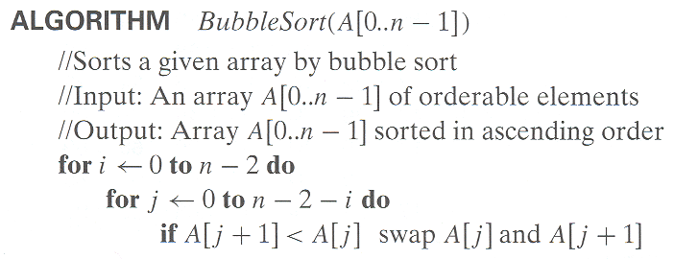
3. Bubble Sort
Topic: Bubble Sort
Notes:
Bubble Sort is a comparison-based sorting algorithm that repeatedly swaps adjacent elements if they are in the wrong order. The process continues until the entire list is sorted.
How it works:
Start from the first element and compare it with the next one.
If they are out of order, swap them.
Move to the next pair and repeat until reaching the end of the list.
The largest element "bubbles" to the correct position at the end of each pass.
Repeat the process for the remaining unsorted elements.
Key Feature: After each pass, the largest remaining element is placed in the correct position, reducing the range of unsorted elements.

Slide 18
3. Bubble Sort: Example
Start at the beginning of the array
Compare the first item to the second
If the items are out of order, swap them and step forward in the array
Continue doing this until you reach the end of the array
Each pass through the array will always end with at least one value being placed at the correct index
Notes:
Consider the unsorted list: 📌 Initial List: [6, 5, 3, 1, 8, 7, 2, 4]
🔹 Pass 1: Compare adjacent elements and swap if necessary. 📌 After Pass 1: [5, 3, 1, 6, 7, 2, 4, 8] (8 is now correctly placed)
🔹 Pass 2: Repeat the process, ignoring the last element. 📌 After Pass 2: [3, 1, 5, 6, 2, 4, 7, 8] (7 is now in place)
🔹 Pass 3: Continue the process. 📌 After Pass 3: [1, 3, 5, 2, 4, 6, 7, 8]
🔹 Pass 4: The process repeats until the entire list is sorted. 📌 Final Sorted List: [1, 2, 3, 4, 5, 6, 7, 8]
Observation: Each pass ensures the next largest number moves into its correct position. The algorithm keeps comparing and swapping until no more swaps are needed.

Slide 19
3. Bubble Sort: Extra example
Start at the beginning (or end) of the array
Compare the first item to the second
If the items are out of order, swap them and step forward in the array
Continue doing this until you reach the end of the array
Each pass through the array will always end with at least one value being placed at the correct index
Notes:
This example visually represents another the swapping process:
📌 Initial List: [5, 9, 6, 4, 7, 2, 3, 1, 8] ✅ First pass: The smallest number moves to the correct position at the begin. ✅ Second pass: The second-smallest number moves to its correct position. ✅ Continues until the list is fully sorted.

Slide 20
4. Merge Sort
Merge sort is a sorting algorithm based on the divide-and-conquer paradigm
Like the quadratic sorts, merge sort is comparative
Unlike the quadratic sorts, merge sort is recursive and runs in linearithmic, O(n log n), time!
Let’s see why…
Topic: Merge Sort
Notes:
Merge Sort is a divide-and-conquer sorting algorithm that works by recursively breaking down a list into smaller sublists and merging them back in sorted order.
Key Characteristics:
Comparative Sorting Algorithm: It sorts elements by comparing them.
Recursive Approach: The list is divided into halves until each sublist has only one element.
Time Complexity: Unlike quadratic sorting algorithms (Bubble Sort, Selection Sort, Insertion Sort), Merge Sort runs in O(n log n) time, making it efficient for large datasets.

Slide 21
Divide-and-Conquer
Divide-and-conquer is a general algorithm design paradigm:
Divide: divide the input data S into disjoint subsets S₁, S₂, …, S_{k}
Recur: solve the subproblems associated with S₁, S₂, …, S_{k}
Conquer: combine the solutions for S₁, S₂, …, S_{k} into a solution for S
The base case for the recursion is generally subproblems of size 0 or 1
Topic: Merge Sort
Notes:
Merge Sort follows the divide-and-conquer approach, which consists of three steps:
Divide: Split the input list into two equal halves.
Recur: Recursively sort both halves using Merge Sort.
Conquer: Merge the sorted halves back into a single sorted list.
Base Case: The recursion stops when a sublist contains one element or no elements, as a list of size 1 is already sorted.
The recursive nature of Merge Sort ensures that each smaller problem is solved independently before merging.

Slide 22
Merge Sort is a divide and conquer algorithm
Merge sort on an input sequence S with n elements consists of three steps:
Divide: partition S into two sequences S₁ and S₂ of n/2 elements each
Recur: recursively merge sort S₁ and S₂
Conquer: merge S₁ and S₂ into a sorted sequence
Topic: Merge Sort
Notes:
The first phase of Merge Sort involves dividing the original list into smaller sublists:
The input list S of n elements is partitioned into two halves:
S1​: Contains the first n/2 elements.
S2​: Contains the remaining n/2 elements.
This process continues recursively:
Each sublist S1 and S2​ is further divided into two halves.
The division stops when the sublists are reduced to a single element or are empty. A list with one element is inherently sorted.
In the recursive sort phase:
Each sublist obtained from the divide step is sorted using Merge Sort:
Since each sublist is already divided down to a single element, the recursion base case is reached.
The recursion then unfolds, with each level of the recursive tree representing a partially sorted list.
The final phase is the merge step, where the sorted sublists are combined to form a fully sorted list. This process involves:
Two pointers: One for each sublist S1​ and S2​, starting at the first element.
Comparisons: The elements at the pointers are compared, and the smaller element is placed in the merged list.
Advancing pointers: The pointer of the sublist from which the smaller element was taken is advanced to the next element.
Continuing until completion: This process continues until all elements from both sublists are merged in sorted order.

Slide 23
Merge Sort: Example
The execution of merge sort can be depicted by a binary tree
each node represents a subproblem in merge sort, showing the unsorted subproblem before calling merge sort recursively
the root is the initial call
the leaves are the base cases of the recursion, with subsequences of size 0 or 1
Topic: Merge Sort
Notes:
Merge Sort splits an array into smaller parts until each sublist contains only one element. This division follows a binary tree structure, where:
Each node represents a sublist being processed by Merge Sort.
The root node represents the entire unsorted list.
Each level of the tree corresponds to a recursive step in Merge Sort.
The leaf nodes represent the base case (individual elements, which are inherently sorted).
The merging process happens bottom-up, where sorted sublists are merged back at each level until the final sorted list is obtained.
This visualization helps in understanding how Merge Sort systematically reduces the problem into smaller parts and then reconstructs the sorted list efficiently.

Slide 24
Merge Sort: Example
Notes:
Example: Sorting [6, 5, 3, 1, 8, 7, 2, 4] using Merge Sort

Slide 25
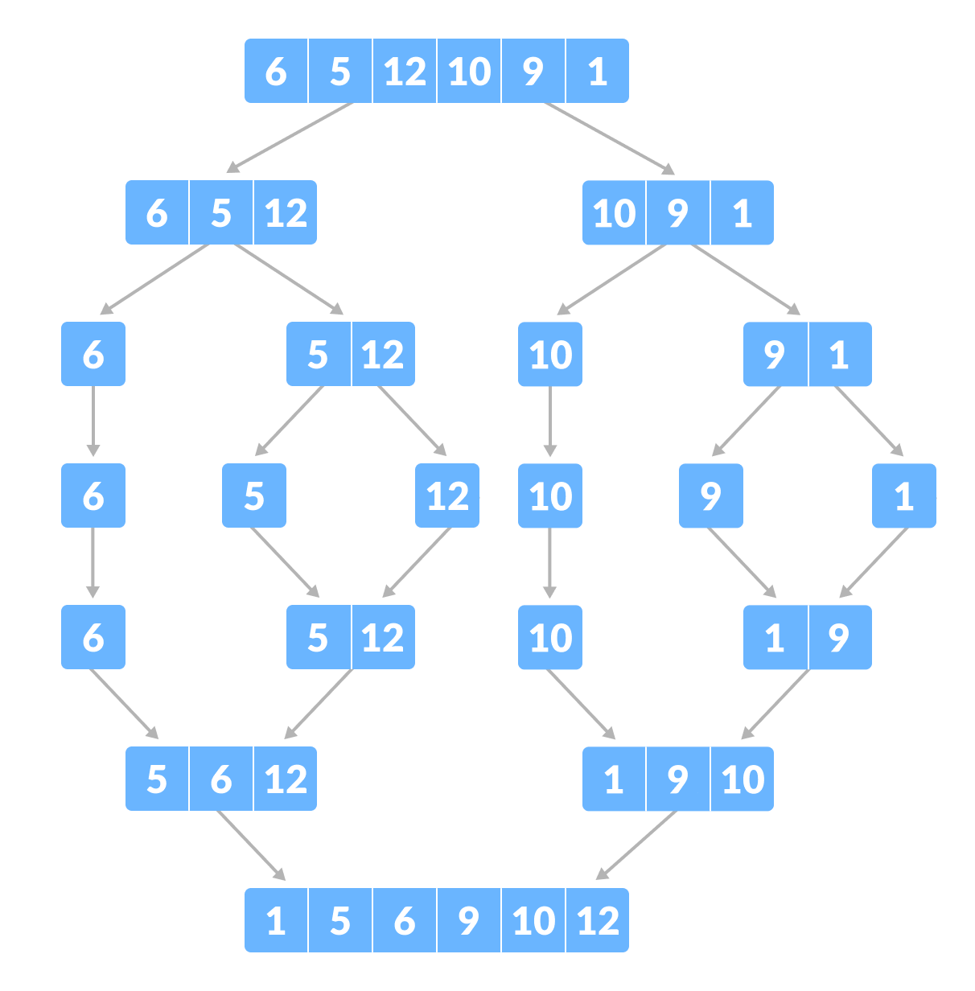
Merge Sort: Another Example
Notes:
Splitting Phase (Top-Down Approach)
The unsorted list is recursively divided into smaller parts until each sublist contains only one element.
The list is first split into two halves: a left half and a right half.
Each half is further divided into smaller sublists.
The process continues until each sublist contains a single element, which forms the base case of recursion.
At this point, the list is fully broken down into individual elements, forming the leaf nodes of the binary tree.
Merging Phase (Bottom-Up Approach)
Once the list is fully split, the merging process begins.
Adjacent elements are merged in sorted order to form small sorted sublists.
These sorted sublists are merged again to create larger sorted groups.
The process continues until all elements are merged back together into a fully sorted list.

Slide 26
Merge Sort: Another Example
Suppose we want to sort [7, 2, 9, 4, 3, 8, 6, 1]
Topic: Merge Sort
Notes:
Suppose we need to sort the list [7, 2, 9, 4, 3, 8, 6, 1]. Merge Sort will break it down into smaller pieces, sort them, and then merge them back together in a structured way.

Slide 27
Merge Sort: Example (2)
Partition
7 2 9 4 ⏐ 3 8 6 1 → 1 2 3 4 6 7 8 9
7 2 9 4 → 2 4 7 9
3 8 6 1 → 1 3 8 6
7 2 → 2 7
9 4 → 4 9
3 8 → 3 8
6 1 → 1 6
Topic: Merge Sort
Notes:
The first step is dividing the list into two halves. The left half contains [7, 2, 9, 4], and the right half contains [3, 8, 6, 1]. This step repeats until we reach individual elements.

Slide 28
Merge Sort: Example (3)
Recursive call, partition
7 2 9 4 ⏐ 3 8 6 1 → 1 2 3 4 6 7 8 9
7 2 ⏐ 9 4 → 2 4 7 9
3 8 6 1 → 1 3 8 6
7 2 → 2 7
9 4 → 4 9
3 8 → 3 8
6 1 → 1 6
Topic: Merge Sort
Notes:
We continue splitting the left half [7, 2, 9, 4] into [7, 2] and [9, 4]. The right half will follow the same process.

Slide 29
Merge Sort: Example (4)
Recursive call, partition
7 2 9 4 ⏐ 3 8 6 1 → 1 2 3 4 6 7 8 9
7 2 ⏐ 9 4 → 2 4 7 9
3 8 6 1 → 1 3 8 6
7 ⏐ 2 → 2 7
9 4 → 4 9
3 8 → 3 8
6 1 → 1 6
Topic: Merge Sort
Notes:
The left half [7, 2] is divided again into [7] and [2]. This continues until all elements are separated.

Slide 30
Merge Sort: Example (5)
Recursive call, base case
7 2 9 4 ⏐ 3 8 6 1 → 1 2 3 4 6 7 8 9
7 2 ⏐ 9 4 → 2 4 7 9
3 8 6 1 → 1 3 8 6
7 ⏐ 2 → 2 7
9 4 → 4 9
3 8 → 3 8
6 1 → 1 6
7 → 7
2 → 2
9 → 9
4 → 4
3 → 3
8 → 8
6 → 6
1 → 1
Topic: Merge Sort
Notes:
Now that we have reached single-element lists, they are considered sorted. We can now start merging.

Slide 31
Merge Sort: Example (6)
Recursive call, base case
7 2 9 4 ⏐ 3 8 6 1 → 1 2 3 4 6 7 8 9
7 2 ⏐ 9 4 → 2 4 7 9
3 8 6 1 → 1 3 8 6
7 ⏐ 2 → 2 7
9 4 → 4 9
3 8 → 3 8
6 1 → 1 6
7 → 7
2 → 2
9 → 9
4 → 4
3 → 3
8 → 8
6 → 6
1 → 1
Topic: Merge Sort
Notes:
Similarly, we reach another base case with [2]. Each single element will now be merged in sorted order.

Slide 32
Merge Sort: Example (7)
Merge
7 2 9 4 ⏐ 3 8 6 1 → 1 2 3 4 6 7 8 9
7 2 ⏐ 9 4 → 2 4 7 9
3 8 6 1 → 1 3 8 6
7 ⏐ 2 → 2 7
9 4 → 4 9
3 8 → 3 8
6 1 → 1 6
7 → 7
2 → 2
9 → 9
4 → 4
3 → 3
8 → 8
6 → 6
1 → 1
Topic: Merge Sort
Notes:
Now, we begin merging: [7] and [2] are merged into [2, 7]. The merging process ensures that elements are arranged correctly.

Slide 33
Merge Sort: Example (8)
Recursive call, …, base case, merge
7 2 9 4 ⏐ 3 8 6 1 → 1 2 3 4 6 7 8 9
7 2 ⏐ 9 4 → 2 4 7 9
3 8 6 1 → 1 3 8 6
7 ⏐ 2 → 2 7
9 4 → 4 9
3 8 → 3 8
6 1 → 1 6
7 → 7
2 → 2
9 → 9
4 → 4
3 → 3
8 → 8
6 → 6
1 → 1
Topic: Merge Sort
Notes:
The next step follows the same approach. [9] and [4] are merged into [4, 9].

Slide 34
Merge Sort: Example (9)
Merge
7 2 9 4 ⏐ 3 8 6 1 → 1 2 3 4 6 7 8 9
7 2 ⏐ 9 4 → 2 4 7 9
3 8 6 1 → 1 3 8 6
7 ⏐ 2 → 2 7
9 4 → 4 9
3 8 → 3 8
6 1 → 1 6
7 → 7
2 → 2
9 → 9
4 → 4
3 → 3
8 → 8
6 → 6
1 → 1
Topic: Merge Sort
Notes:
Now, the sorted sublists [2, 7] and [4, 9] are merged into [2, 4, 7, 9]. The left half is now sorted.

Slide 35
Merge Sort: Example (10)
Recursive call, …, merge, merge
7 2 9 4 ⏐ 3 8 6 1 → 1 2 3 4 6 7 8 9
7 2 ⏐ 9 4 → 2 4 7 9
3 8 6 1 → 1 3 6 8
7 ⏐ 2 → 2 7
9 4 → 4 9
3 8 → 3 8
6 1 → 1 6
7 → 7
2 → 2
9 → 9
4 → 4
3 → 3
8 → 8
6 → 6
1 → 1
Topic: Merge Sort
Notes:
Meanwhile, the right half [3, 8, 6, 1] undergoes the same process, breaking down into smaller parts and merging step by step.
After merging individual elements, we get [1, 3, 6, 8] on the right side.

Slide 36
Merge Sort: Example (11)
Final merge and return
7 2 9 4 ⏐ 3 8 6 1 → 1 2 3 4 6 7 8 9
7 2 ⏐ 9 4 → 2 4 7 9
3 8 6 1 → 1 3 6 8
7 ⏐ 2 → 2 7
9 4 → 4 9
3 8 → 3 8
6 1 → 1 6
7 → 7
2 → 2
9 → 9
4 → 4
3 → 3
8 → 8
6 → 6
1 → 1
Topic: Merge Sort
Notes:
Now that both halves are fully sorted, we merge them together.
The left half [2, 4, 7, 9] and the right half [1, 3, 6, 8] are compared and combined into a single sorted list [1, 2, 3, 4, 6, 7, 8, 9]. The Merge Sort process is now complete, and we return the fully sorted list.

Slide 37
Merge Sort Pseudocode
function mergeSort(A):
// Input: an unsorted array a
// Output: array a in sorted order
n = A.length
if n <= 1:
return A
mid = n/2 left = mergeSort(A[0 ... mid-1])
right = mergeSort(A[mid ... n-1])
return merge(left, right)
Topic: Merge Sort
Notes:
The mergeSort function follows a recursive approach:
If the array has one or zero elements, it is already sorted, so we return it.
Otherwise, the array is split in half.
The left and right halves are recursively sorted.
Finally, the two sorted halves are merged together.
This step ensures that every subproblem is broken down until it reaches the base case, making it easier to solve.

Slide 38
Merge Sort Pseudocode (2)
function merge(A, B):
result = [] aIndex = 0
bIndex = 0
while aIndex < A.length and bIndex < B.length:
if A[aIndex] <= B[bIndex]:
result.append(A[aIndex])
aIndex++
else:
result.append(B[bIndex])
bIndex++
if aIndex < A.length:
result = result + A[aIndex:end]
if bIndex < B.length:
result = result + B[bIndex:end] return result
Topic: Merge Sort
Notes:
The merge function is responsible for combining two sorted subarrays into one sorted array:
It compares elements from both subarrays.
The smaller element is added to the result first.
This continues until all elements are placed in order.
Any remaining elements from either subarray are appended.
Merging is a crucial step, as it ensures that the sorted order is maintained while combining smaller lists into larger ones.

Slide 39
Merge Sort Recurrence Relation
Steps to merge sort:
Recursively merge sort the left half of the list
Recursively merge sort the right half of the list
Merge both halves together
Let T(n) be the running time of merge sort on an input of size n
T(n) = step 1 + step 2 + step3
Notice that steps 1 and 2 are simply merge sorts on half the input and step 3 runs in O(n) time
T(n) = T(n/2) + T(n/2) + O(n)
= 2T(n/2) + O(n)
Topic: Merge Sort
Notes:
Merge sort's time complexity can be expressed using a recurrence relation:
Step 1: Recursively sort the left half.
Step 2: Recursively sort the right half.
Step 3: Merge the two halves.
Each recursive call divides the array into two halves, and merging takes O(n) time. This leads to the recurrence formula: T(n) = 2T(n/2) + O(n)

Slide 40
Merge Sort Recurrence Solution
Recurrence relation:
Base case: T(1) = c₁
General case: T(n) = 2T(n/2) + O(n)
Manual substitution for a solution:
T(1) = c₁ = c₁
T(2) = 2 T(1) + 2 = 2c₁ + 2
T(4) = 2 T(2) + 4 = 2(2c₁ + 2) + 4 = 4c₁ + 8
T(8) = 2 T(4) + 8 = 2(4c₁ + 8) + 8 = 8c₁ + 24
T(16)= 2 T(8) + 16 = 2(8c₁ + 24) + 16 = 16c₁ + 64
T(n) = nc₁ + n log n
= O(n log n)
Topic: Merge Sort
Notes:
To solve the recurrence relation, we expand the formula:
T(1) = c₁ (Base case)
T(2) = 2T(1) + 2
T(4) = 2T(2) + 4
Continuing this pattern, we find that T(n) resolves to O(n log n).
This proves that merge sort is significantly faster than O(n²) sorting algorithms for large inputs.

Slide 41
Analysis of Merge Sort
To understand why merge sort is O(n log n), notice that the height h of the merge sort tree is O(log n) since it forms a perfect binary tree
Overall amount of work done at each depth k is O(n) to partition and merge 2^{k} sequences of size n/2^{k}
depth | sequences | size
0 | 1 | n
1 | 2 | n/2
2 | 4 | n/4
⋮ | ⋮ | ⋮
k | 2^{k} | n/2^{k}
⋮ | ⋮ | ⋮ | ⋮
Topic: Merge Sort
Notes:
Why does merge sort run in O(n log n) time?
The merge sort tree has a height of O(log n) since the array is repeatedly split in half.
Each level of the tree requires O(n) work to merge sequences back together.
The total work done across all levels is O(n log n).
This makes merge sort highly efficient for large datasets compared to quadratic-time sorting algorithms.

Slide 42
Summary
Sorting Overview - Sorting is a fundamental operation that arranges elements in a specific order.
Sorting Techniques Covered – Selection Sort, Insertion Sort, Bubble Sort & Merge Sort
Performance Comparison
Selection Sort & Bubble Sort: O(n²) time complexity
Insertion Sort: O(n²) worst case, O(n) best case
Merge Sort: O(n log n) in all cases
Notes:
Sorting Overview
Sorting is a fundamental operation that arranges elements in a specific order.
Algorithms can be comparison-based or non-comparison-based.
Sorting Techniques Covered
Selection Sort: Finds the smallest element and swaps it into place.
Insertion Sort: Inserts each element into its correct position in a sorted portion.
Bubble Sort: Repeatedly swaps adjacent elements if they are in the wrong order.
Merge Sort: A divide-and-conquer algorithm that splits and merges sorted halves.
Performance Comparison
Selection Sort & Bubble Sort: O(n^2) time complexity, simple but inefficient for large datasets.
Insertion Sort: O(n^2) worst case but efficient for nearly sorted data (O(n)O(n)O(n) best case).
Merge Sort: O(n logn) in all cases, more efficient than quadratic sorts but requires extra space.
Key Takeaways
Quadratic sorts (Selection, Insertion, Bubble) are simple but slow for large datasets.
Merge Sort is much faster for larger inputs, making it a practical choice for efficient sorting.
Sorting efficiency depends on the size of input, memory constraints, and initial order of elements.

